Slide 1

Health Disparities Research
Module 4
Genetic ancestry inference & modeling
Session 9

Slide 2
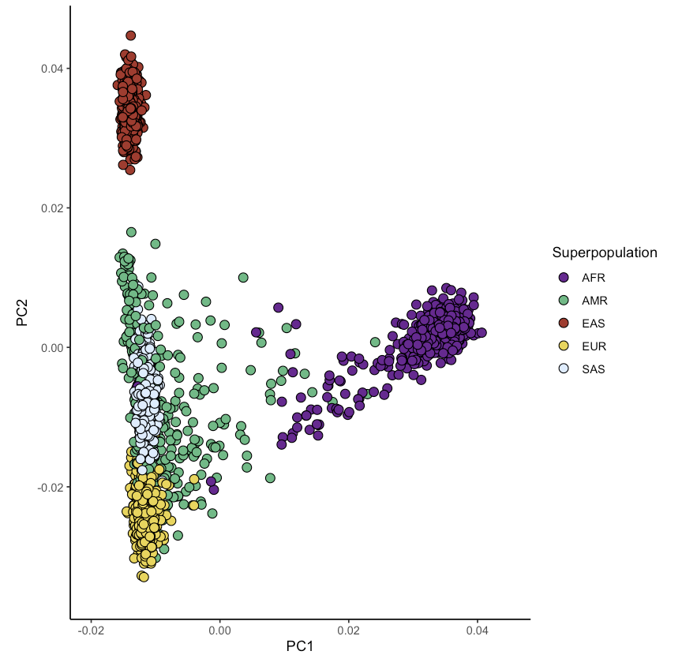
Quick recap
We have now seen how genomic data are stored and represented
We were able to characterize genetic diversity using a dataset from the 1000 Genomes Project using PCA
We can see the different poles of human genetic diversity represented

Slide 3
Characterizing genetic ancestry
We can categorize genetic ancestry at different levels
Categorical designation
Continuous designation

Slide 4
Categorical designation of genetic ancestry

Slide 5
Supervised categorical ascription
Let’s assume we get a new, uncharacterized sample
How can we add a categorical label to this new sample?

Slide 6
Supervised clustering with the K-nearest neighbor algorithm
Extremely simple algorithm:
Calculate distance to all points
Pick K closest neighbors
Add label based on majority rule
# | Distance to new point | Label
1 | 0.12 | AFR
2 | 0.13 | AFR
3 | 0.14 | AFR
With K = 3

Slide 7
What if we don’t trust population labels?
There may be situation where we want to partition our data into groups based on empirical data
This can help us assess the concordance between reported and inferred labels
This calls for unsupervised clustering!

Slide 8
K-means clustering for unsupervised clustering
A very simple algorithm for unsupervised clustering
Identify number of clusters (K)
Initialize K random seed points
Assign all points in the dataset to their nearest seed point
Update the location of the seed point to the centroid of the grouped data points
Repeat 3 and 4 until the location of the seed point stabilizes

Slide 9
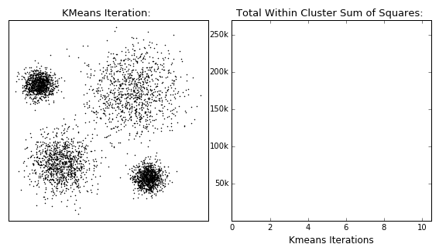
K-means clustering for unsupervised clustering
Source: David Sheehan’s Github

Slide 10
Continuous genetic ancestry inference

Slide 11
Model-based ancestry inference
This idea was published in Pritchard, Stephens, and Donelly, 2000. Genetics.
It starts with defining the concept of a population
An idealized concept of a discrete group of random-mating individuals
Implies that different populations will have different allele frequencies

Slide 12
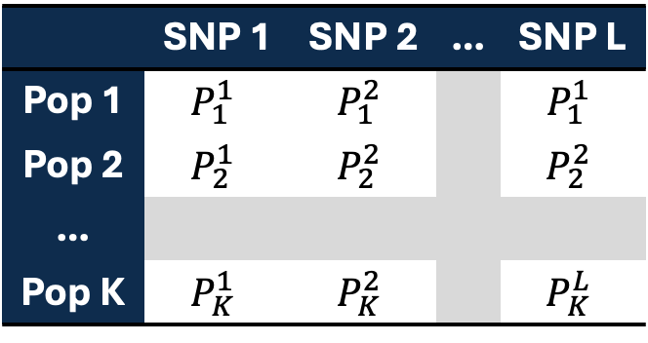
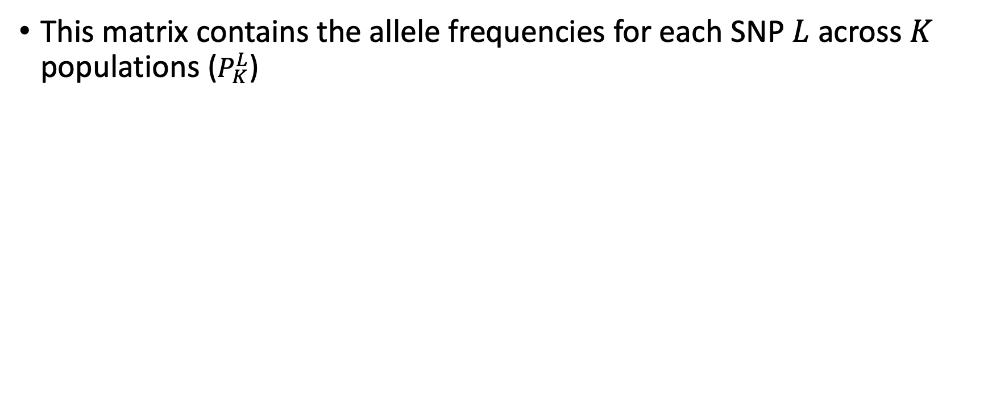
The P matrix – frequencies of SNPs in a population
This matrix contains the allele frequencies for each SNP $L$ across $K$ populations ($P_{K}^{L}$)
 | SNP 1 | SNP 2 | … | SNP L
Pop 1 | $$P_{1}^{1}$$ | $$P_{1}^{2}$$ |  | $$P_{1}^{1}$$
Pop 2 | $$P_{2}^{1}$$ | $$P_{2}^{2}$$ |  | $$P_{2}^{2}$$
…
Pop K | $$P_{K}^{1}$$ | $$P_{K}^{2}$$ |  | $$P_{K}^{L}$$

Slide 13
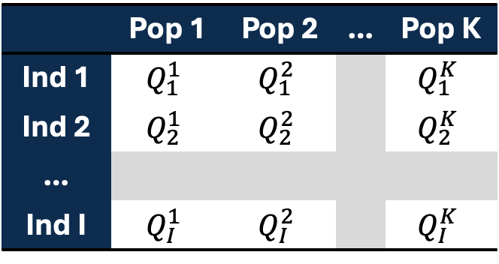
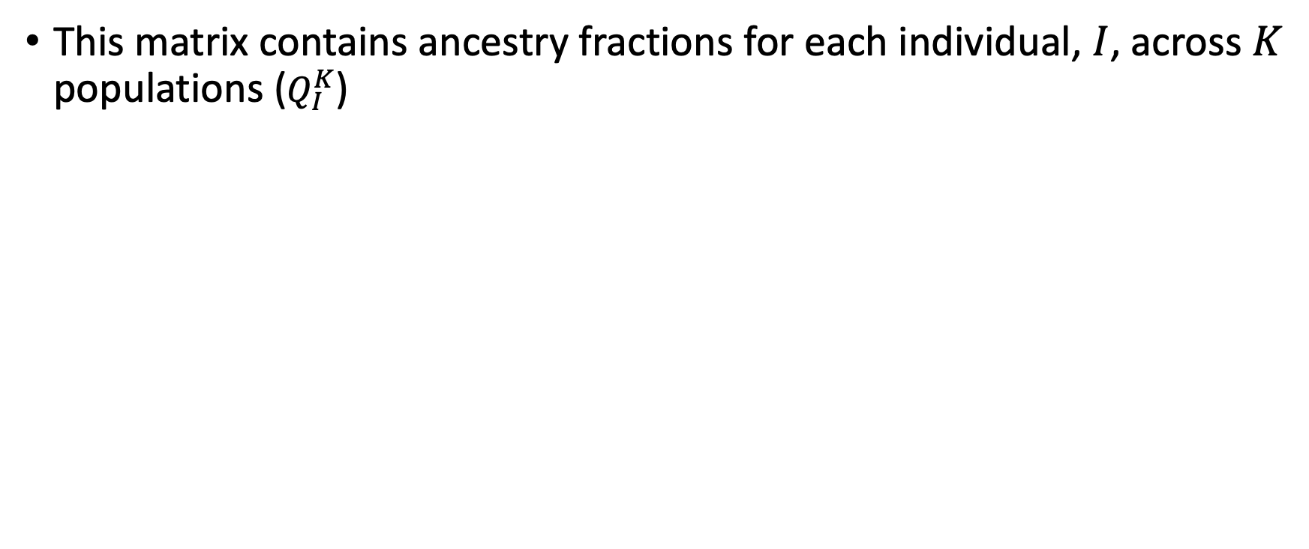
The Q matrix – ancestry matrix
This matrix contains ancestry fractions for each individual, $I$, across $K$ populations ($Q_{I}^{K}$)
 | Pop 1 | Pop 2 | … | Pop K
Ind 1 | $$Q_{1}^{1}$$ | $$Q_{1}^{2}$$ |  | $$Q_{1}^{K}$$
Ind 2 | $$Q_{2}^{1}$$ | $$Q_{2}^{2}$$ |  | $$Q_{2}^{K}$$
…
Ind I | $$Q_{I}^{1}$$ | $$Q_{I}^{2}$$ |  | $$Q_{I}^{K}$$

Slide 14
The Q matrix – ancestry matrix
An un-admixed individual:
An admixed individual:
 | Pop 1 | Pop 2 | Pop 3 | Pop 4
Ind 1 | 0 | 1 | 0 | 0
 | Pop 1 | Pop 2 | Pop 3 | Pop 4
Ind 2 | 0.25 | 0 | 0.75 | 0

Slide 15
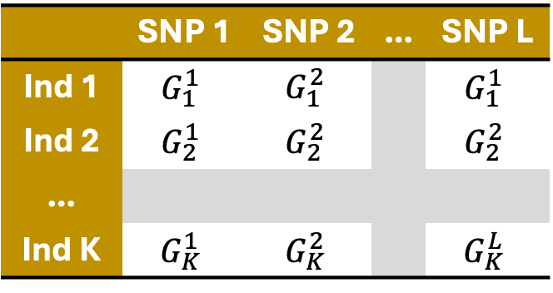
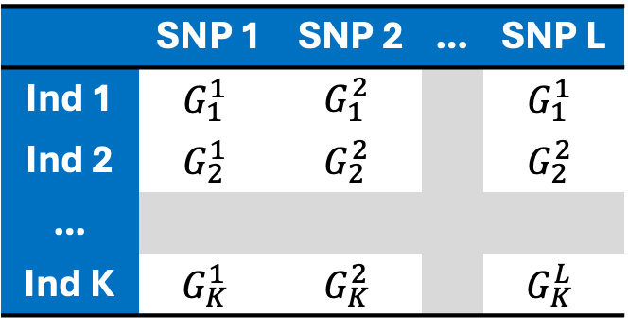
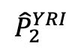
How do we estimate P?
We can use ‘reference’ populations to serve as representatives of ‘true’ populations
E.g., using Yoruba as the African reference and Spanish as the European reference
Yoruba
 | SNP 1 | SNP 2 | … | SNP L
Ind 1 | $$G_{1}^{1}$$ | $$G_{1}^{2}$$ |  | $$G_{1}^{1}$$
Ind 2 | $$G_{2}^{1}$$ | $$G_{2}^{2}$$ |  | $$G_{2}^{2}$$
…
Ind K | $$G_{K}^{1}$$ | $$G_{K}^{2}$$ |  | $$G_{K}^{L}$$
Spanish
 | SNP 1 | SNP 2 | … | SNP L
Ind 1 | $$G_{1}^{1}$$ | $$G_{1}^{2}$$ |  | $$G_{1}^{1}$$
Ind 2 | $$G_{2}^{1}$$ | $$G_{2}^{2}$$ |  | $$G_{2}^{2}$$
…
Ind K | $$G_{K}^{1}$$ | $$G_{K}^{2}$$ |  | $$G_{K}^{L}$$
Average
$${\hat{P}}_{2}^{YRI}$$

Slide 16
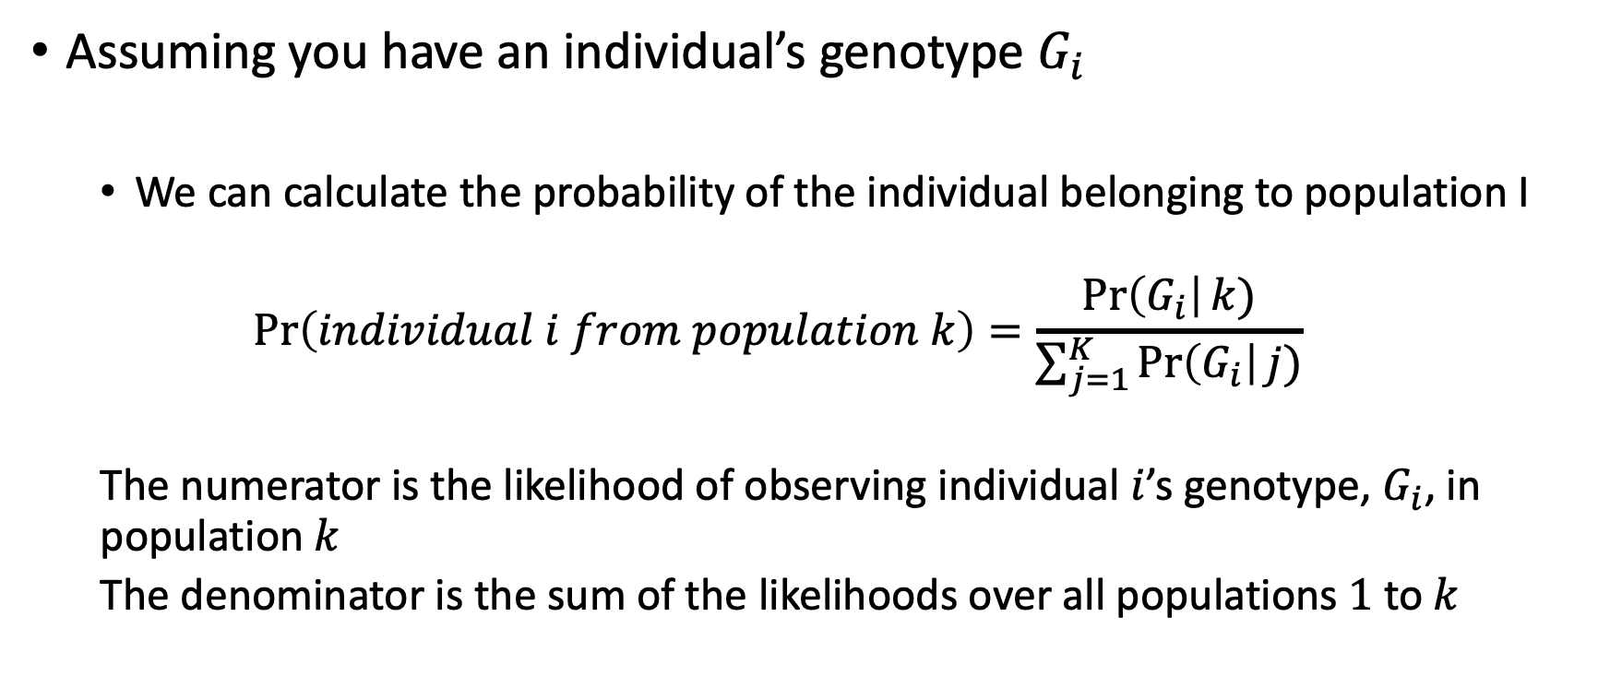
Using P to infer Q using G
Assuming you have an individual’s genotype $G_{i}$
We can calculate the probability of the individual belonging to population I
$$\operatorname{Pr}\left(individual i from population k\right)=\frac{\operatorname{Pr}\left(G_{i}\right|k)}{\sum_{j=1}^{K}{\operatorname{Pr}\left(G_{i}\right|j)}}$$
The numerator is the likelihood of observing individual $i$’s genotype, $G_{i}$, in population $k$
The denominator is the sum of the likelihoods over all populations $1$ to $k$

Slide 17
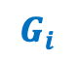
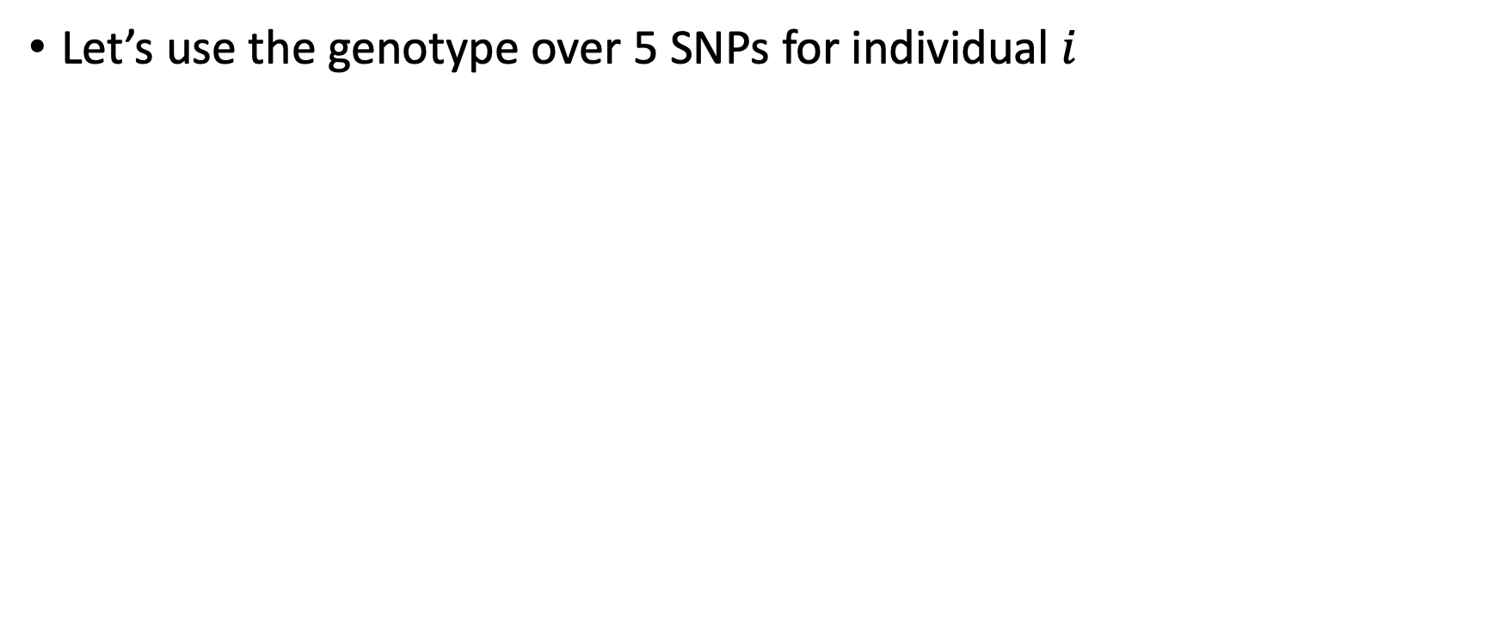

Example: Inferring Q
Let’s use the genotype over 5 SNPs for individual $i$
 | SNP 1 | SNP 2 | SNP 3 | SNP 4 | SNP 5
Ind i | 0 | 2 | 1 | 2 | 0
$$G_{i}$$
 | SNP 1 | SNP 2 | SNP 3 | SNP 4 | SNP 5
Pop 1 | 0.3 | 0.8 | 0.6 | 0.6 | 0.2
Pop 2 | 0.6 | 0.5 | 0.3 | 0.8 | 0.6
$$P$$

Slide 18
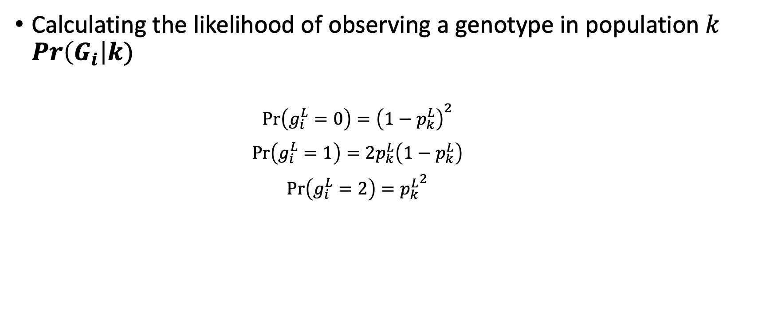
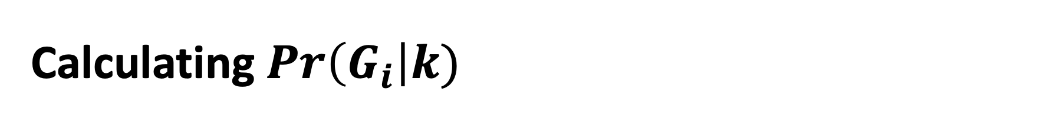
Calculating $Pr\left(G_{i}\right|k)$
Calculating the likelihood of observing a genotype in population $k$ $Pr\left(G_{i}\right|k)$
$$\operatorname{Pr}\left(g_{i}^{L}=0\right)={\left(1−p_{k}^{L}\right)}^{2}$$
$$\operatorname{Pr}\left(g_{i}^{L}=1\right)=2p_{k}^{L}\left(1−p_{k}^{L}\right)$$
$$\operatorname{Pr}\left(g_{i}^{L}=2\right)={p_{k}^{L}}^{2}$$

Slide 19

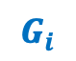
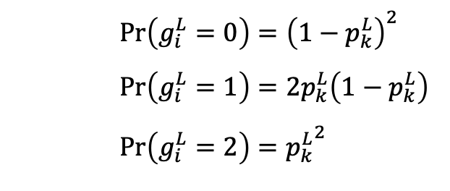


Example: Inferring Q
 | SNP 1 | SNP 2 | SNP 3 | SNP 4 | SNP 5
Ind i | 0 | 2 | 1 | 2 | 0
$$G_{i}$$
$$\operatorname{Pr}\left(g_{i}^{L}=0\right)={\left(1−p_{k}^{L}\right)}^{2}$$
$$\operatorname{Pr}\left(g_{i}^{L}=1\right)=2p_{k}^{L}\left(1−p_{k}^{L}\right)$$
$$\operatorname{Pr}\left(g_{i}^{L}=2\right)={p_{k}^{L}}^{2}$$
Pop 1 | 0.3 | 0.8 | 0.6 | 0.6 | 0.2
Pop 2 | 0.6 | 0.5 | 0.3 | 0.8 | 0.6
$$P$$
$$Pr\left(G_{i}\right|k=1)$$
Ind i
$$Pr\left(G_{i}\right|k=2)$$
Ind i

Slide 20
Example: Inferring Q
 | SNP 1 | SNP 2 | SNP 3 | SNP 4 | SNP 5
Ind i | 0 | 2 | 1 | 2 | 0
$$G_{i}$$
$$\operatorname{Pr}\left(g_{i}^{L}=0\right)={\left(1−p_{k}^{L}\right)}^{2}$$
$$\operatorname{Pr}\left(g_{i}^{L}=1\right)=2p_{k}^{L}\left(1−p_{k}^{L}\right)$$
$$\operatorname{Pr}\left(g_{i}^{L}=2\right)={p_{k}^{L}}^{2}$$
Pop 1 | 0.3 | 0.8 | 0.6 | 0.6 | 0.2
Pop 2 | 0.6 | 0.5 | 0.3 | 0.8 | 0.6
$$P$$
$$Pr\left(G_{i}\right|k=1)$$
Ind i | 0.49 | 0.64 | 0.48 | 0.36 | 0.64
$$Pr\left(G_{i}\right|k=2)$$
Ind i | 0.16 | 0.25 | 0.42 | 0.64 | 0.16

Slide 21
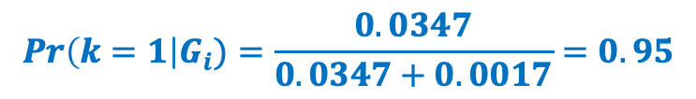
Example: Inferring Q
 | SNP 1 | SNP 2 | SNP 3 | SNP 4 | SNP 5
Ind i | 0 | 2 | 1 | 2 | 0
$$G_{i}$$
$$\operatorname{Pr}\left(g_{i}^{L}=0\right)={\left(1−p_{k}^{L}\right)}^{2}$$
$$\operatorname{Pr}\left(g_{i}^{L}=1\right)=2p_{k}^{L}\left(1−p_{k}^{L}\right)$$
$$\operatorname{Pr}\left(g_{i}^{L}=2\right)={p_{k}^{L}}^{2}$$
Pop 1 | 0.3 | 0.8 | 0.6 | 0.6 | 0.2
Pop 2 | 0.6 | 0.5 | 0.3 | 0.8 | 0.6
$$P$$
$$Pr\left(G_{i}\right|k=1)$$
Ind i | 0.49 | 0.64 | 0.48 | 0.36 | 0.64
= 0.0347
$$Pr\left(G_{i}\right|k=2)$$
Ind i | 0.16 | 0.25 | 0.42 | 0.64 | 0.16
= 0.0017
$$Pr\left(k=1\right|G_{i})=\frac{0.0347}{0.0347+0.0017}=0.95$$

Slide 22
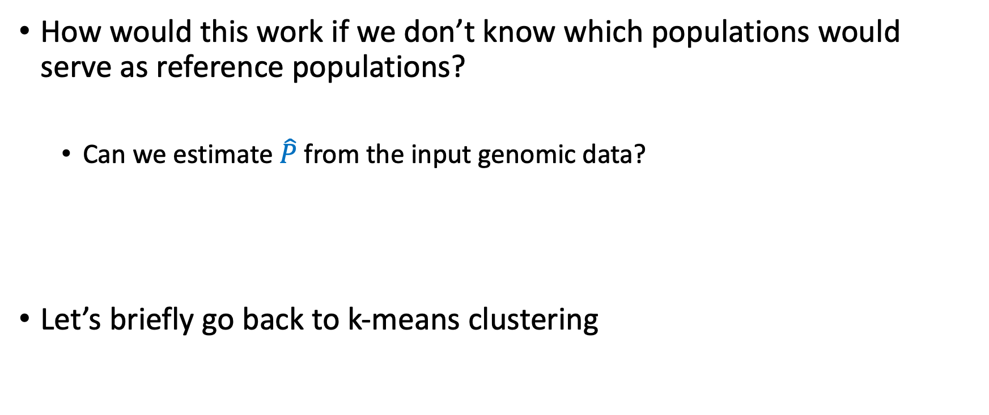
What if we don’t want to make assumptions about P?
How would this work if we don’t know which populations would serve as reference populations?
Can we estimate $\hat{P}$ from the input genomic data?
Let’s briefly go back to k-means clustering

Slide 23
K-means clustering for unsupervised clustering
Source: David Sheehan’s Github

Slide 24
K-means clustering for unsupervised clustering
A very simple algorithm for unsupervised clustering
Identify number of clusters (K)
Initialize K random seed points
Assign all points in the dataset to their nearest seed point
Update the location of the seed point to the centroid of the grouped data points
Repeat 3 and 4 until the location of the seed point stabilizes

Slide 25
K-means clustering for unsupervised clustering
A very simple algorithm for unsupervised clustering
Identify number of clusters (K)
Initialize K random seed points
Assign all points in the dataset to their nearest seed point
Update the location of the seed point to the centroid of the grouped data points
Repeat 3 and 4 until the location of the seed point stabilizes
Initialization

Slide 26
K-means clustering for unsupervised clustering
A very simple algorithm for unsupervised clustering
Identify number of clusters (K)
Initialize K random seed points
Assign all points in the dataset to their nearest seed point
Update the location of the seed point to the centroid of the grouped data points
Repeat 3 and 4 until the location of the seed point stabilizes
Expectation

Slide 27
K-means clustering for unsupervised clustering
A very simple algorithm for unsupervised clustering
Identify number of clusters (K)
Initialize K random seed points
Assign all points in the dataset to their nearest seed point
Update the location of the seed point to the centroid of the grouped data points
Repeat 3 and 4 until the location of the seed point stabilizes
Maximization

Slide 28
Output for k-means clustering
K-means clustering assigns a single category to each input data point
 | Group 1 | Group 2 | Group 3 | Group 4
D 1 | 0 | 1 | 0 | 0
D 2 | 1 | 0 | 0 | 0
…
D K | 0 | 0 | 1 | 0

Slide 29
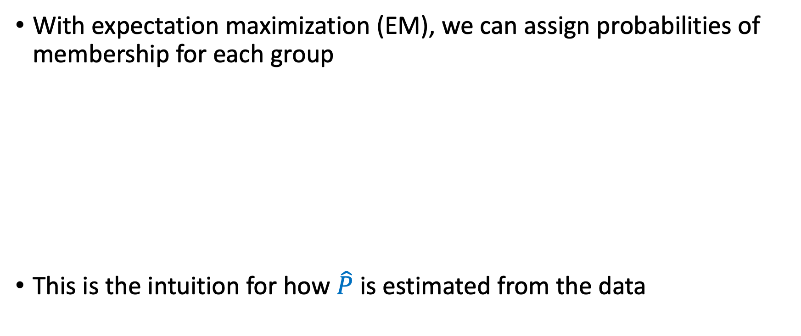
Extending this to a probability
With expectation maximization (EM), we can assign probabilities of membership for each group
This is the intuition for how $\hat{P}$ is estimated from the data
 | Group 1 | Group 2 | Group 3 | Group 4
D 1 | 0.00 | 0.97 | 0.02 | 0.01
D 2 | 0.88 | 0.10 | 0.02 | 0.00
…
D K | 0.01 | 0.08 | 0.91 | 0.00

Slide 30
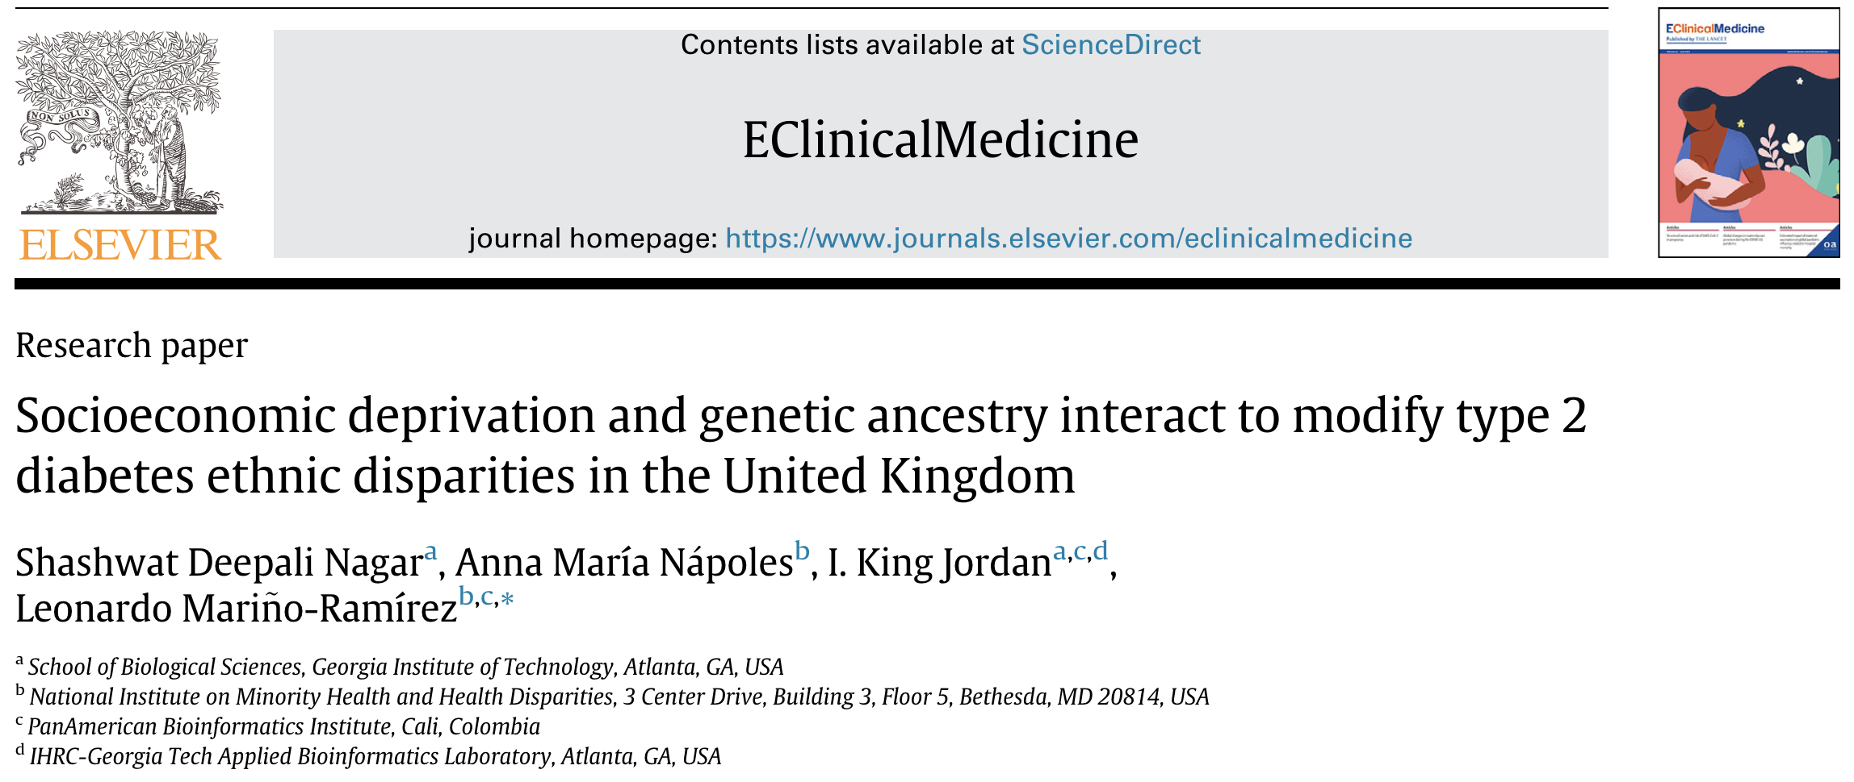
Modeling the interplay between genetics and environment for health disparities
Using one of our publications as an example:

Slide 31
Type 2 diabetes (T2D)
Type 2 diabetes (T2D) is a complex common disease
Minority populations often bear a disproportionately high burden of T2D in developed nations
Socioeconomic deprivation is often seen as a risk factor for T2D

Slide 32
Study questions
Is type 2 diabetes (T2D) an ethnic health disparity in the UK?
Can socioeconomic deprivation (SED) explain the disparity, if found?
Do genetic ancestry (GA) and SED interact to modify T2D ethnic health disparities in the UK?

Slide 33
Type 2 diabetes in the UK Biobank

Slide 34
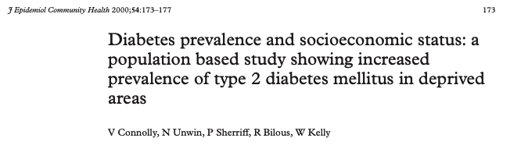
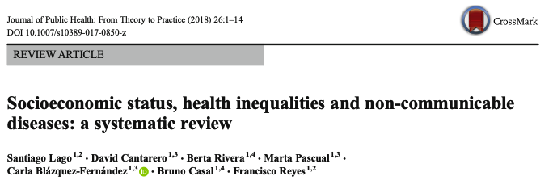
Socioeconomic deprivation (SED) and T2D
Socioeconomic deprivation is known to impact type 2 diabetes health disparities

Slide 35
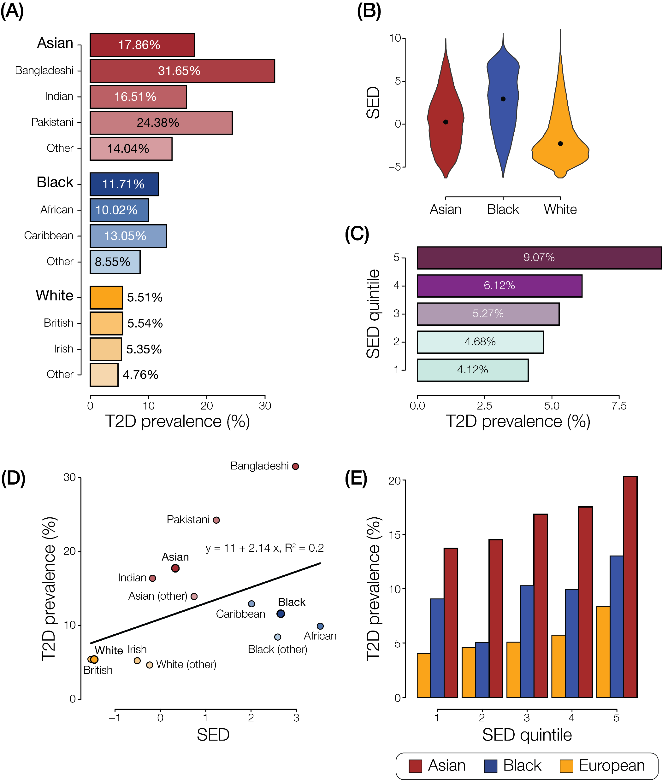
SED, T2D, and ethnicity
Genetic ancestry might play a role!

Slide 36
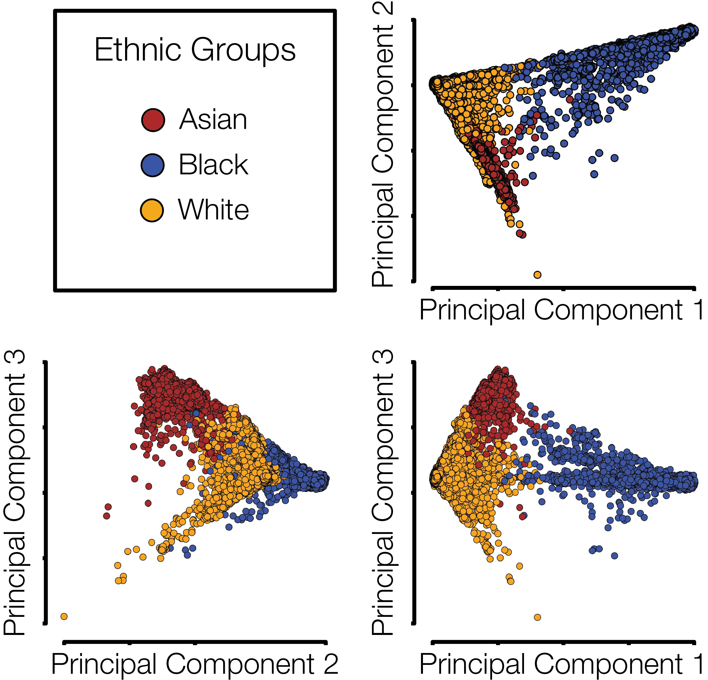
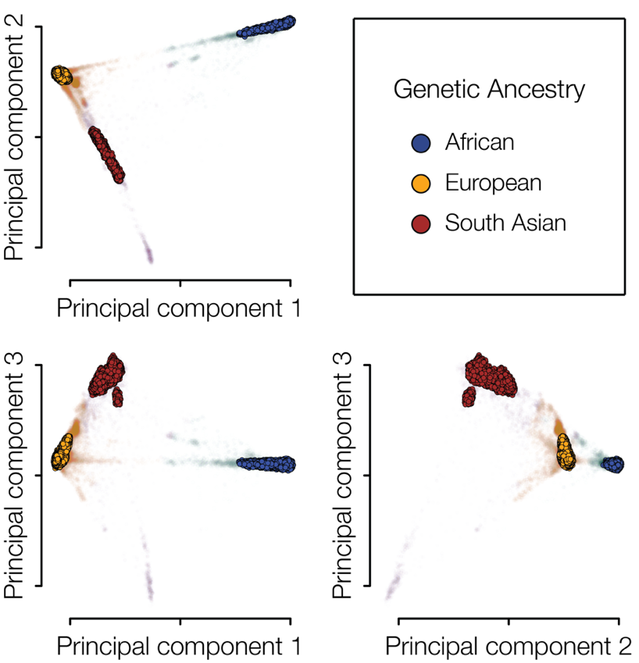
Genetic ancestry (GA)
GA groups were delineated using density-based clustering of the genetic principal components data

Slide 37
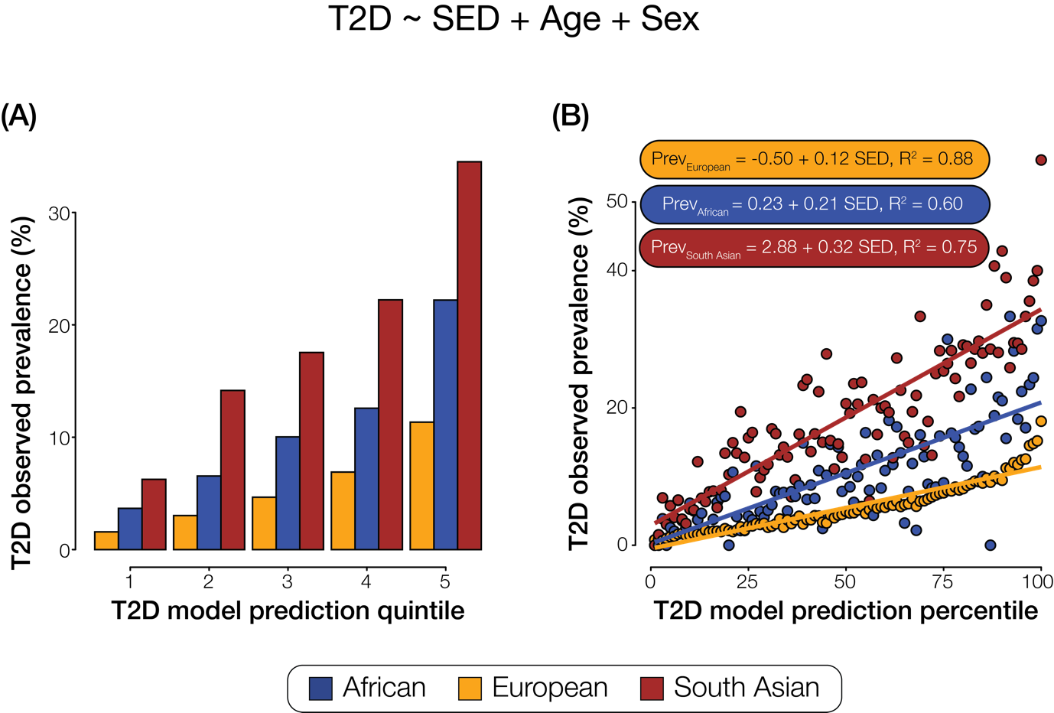
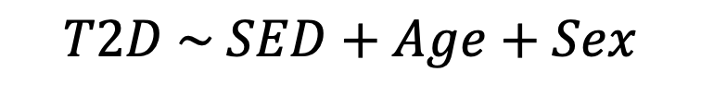
GA, SED, and T2D
$$T2D \sim SED+Age+Sex$$
We see an interaction between SED and GA

Slide 38
Takeaways
There is an interaction between GA and SED when predicting T2D status
Lifestyle factors that co-vary with higher SED increase the risk for participants identifying as Asian more than they do for those identifying as White
Different lifestyle factors co-vary with higher SED in participants who identify as Asian and those who identify as White which increase their risk of T2D

